Slide 1

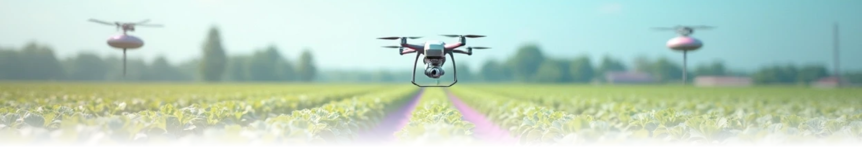
AgriSense: A Smart Crop Tech Solution

Slide 2

CONTENTS
1. Project Overview
2. The Problem Statement
3. Our Solution: AgriSense
4. System Architecture
5. Module Breakdown
6. Key Features in Action
7. The Technology Stack
8. How It Works - The Prediction Flow
9. Customization and Extensibility
10. Installation and Usage
11. Summary & Impact
12. Thank You & Q&A

Slide 3


01
Project Overview

Slide 4


What is AgriSense?
AgriSense is an intelligent, user-friendly desktop application designed to empower farmers, researchers, and agri-tech enthusiasts with data-driven insights.
Key Objectives
• Crop Recommendation: Recommend the most suitable crops based on soil and environmental conditions.
• Fertilizer Suggestions: Suggest the right fertilizers to optimize nutrient management.
• Yield Prediction: Predict crop yield with high accuracy.
• Data Visualization: Visualize complex agricultural data for better understanding.
• Simplified Data Management: Simplify data management with easy import/export features.
Core Technology: Built with Python, Tkinter, and powered by Machine Learning.

Slide 5

02
The Problem Statement

Slide 6



Challenges in Modern Agriculture
Farmers face several challenges that hinder effective farming practices:
Decision Paralysis: Farmers often experience uncertainty about which crops to plant for maximum profitability and sustainability.
Inefficient Resource Use: Incorrect fertilizer application leads to soil degradation, wasted resources, and environmental pollution.
Yield Uncertainty: Lack of accurate yield forecasts complicates financial planning and supply chain management.
Data Overload: While data is increasingly available, there is a need for simple tools to interpret it effectively.
The Need: A user-friendly, intelligent system that translates raw data into actionable advice.

Slide 7

03
Our Solution: AgriSense

Slide 8
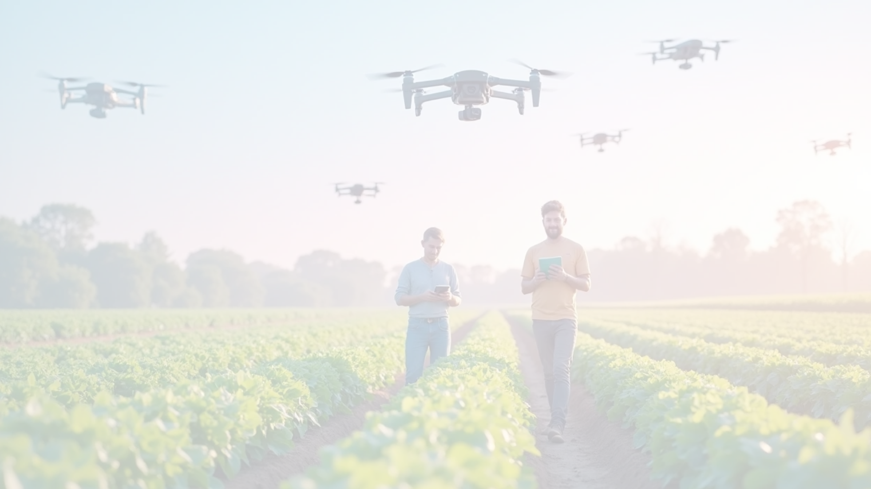

An Integrated Approach to Smart Farming
AgriSense combines several key components into one seamless platform:
AI/ML Models
Utilizes Random Forest algorithms for robust and accurate predictions.
Interactive GUI
A clean and intuitive user interface built with Tkinter for ease of use.
Data Management
Simple tools to generate, import, export, and manage datasets.
Visual Analytics
Interactive charts and graphs to explore data trends and insights.
Key Benefits
• Modular & Extensible: Easily customizable for new crops, regions, or data.
• Fast & Efficient: Delivers predictions in seconds.
• 100% Local & Private: All data is processed on your machine, ensuring complete privacy.

Slide 9

04
System Architecture

Slide 10

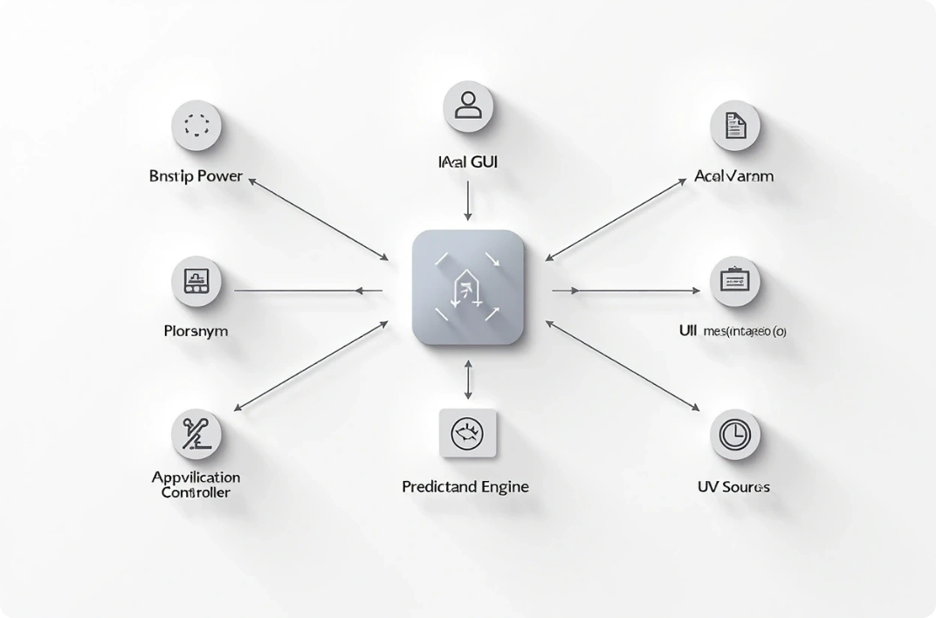
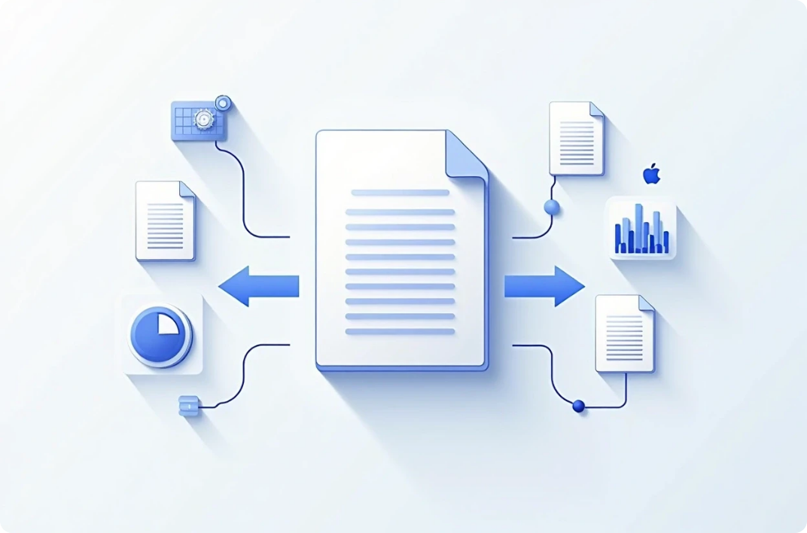
A Modular and Scalable Design
The application is built with a clear separation of concerns
Main GUI (Tkinter)
Data Manager
(Application Controller) UI Components (Input Panels, Results, Views) Prediction Engine ML Models (Orchestrates Predictions) (Random Forest Classifier/ Regressor)
(Import/Export/Validate) Data & Visualizations (CSV Files, Matplotlib Plots)
making it easy to maintain and extend.

Slide 11

05
Module Breakdown

Slide 12


Module Overview
config.py: The central hub for all constants, styles, and static data (crop info, fertilizer details). Makes customization simple.
data_generator.py: Creates synthetic datasets for demonstration and model training.
data_manager.py: Handles all data operations, including CSV import/export and validation.
ml_models.py: Contains the core machine learning logic for training models and making predictions.
prediction_engine.py: Formats user inputs, calls the ML models, and structures the output for the GUI.
visualizations.py: Generates interactive plots using Matplotlib and Seaborn.
ui_components.py: A library of reusable Tkinter widgets for building the user interface.
main_gui.py: The main entry point that ties all the modules together to run the application.

Slide 13

06
Key Features in Action

Slide 14
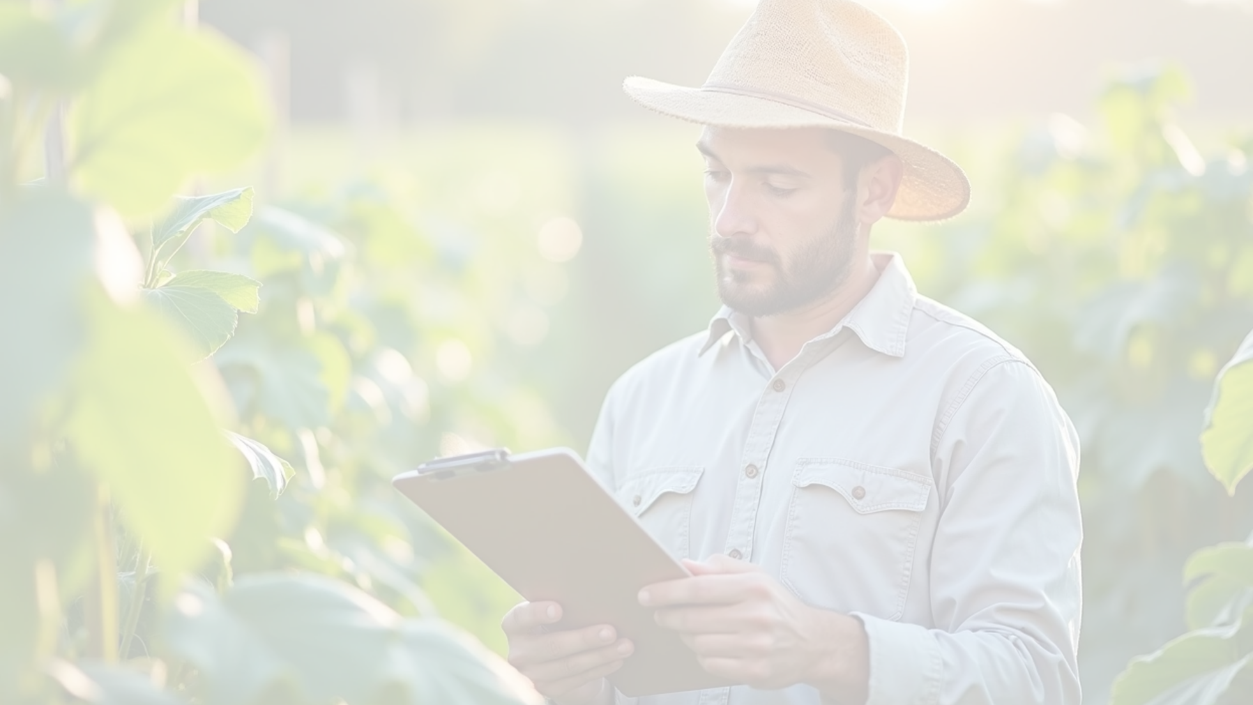

Feature Highlights
Crop Recommendation:
Fertilizer Recommendation:
• Input: N, P, K values, temperature, humidity, pH, and rainfall.
• Input: Soil type, crop type, and current nutrient levels.
• Output: Suggested fertilizer, nutrient analysis, and application guidance.
• Output: The most recommended crop with a confidence score and cultivation tips.
Yield Prediction:
Data Visualization & Management:
• Input: Location (State/District), crop, area, and historical production data.
• Explore data distributions and correlations through interactive charts.
• Output: Predicted yield per hectare and actionable insights.
• Easily import your own datasets, retrain models, and export results.

Slide 15

07
The Technology Stack

Slide 16
The Technology Stack
Category | Technology
Language | Python 3.7+
GUI Framework | Tkinter
ML Library | Scikit-learn (for Random Forest models)
Data Handling | Pandas, NumPy
Visualization | Matplotlib, Seaborn
Data Format | CSV

Slide 17

08
How It Works - The Prediction Flow

Slide 18


Three-Step Process
Input
• User enters soil, weather, and crop data into the intuitive GUI.
Process
• The Prediction Engine validates and encodes the input.
• The pre-trained ML Model processes the data and generates a prediction.
Output
• The result is formatted with confidence scores, tips, and analysis.
• The GUI displays the final recommendation in a clear, easy-to-understand format.

Slide 19
09
Customization and Extensibility

Slide 20
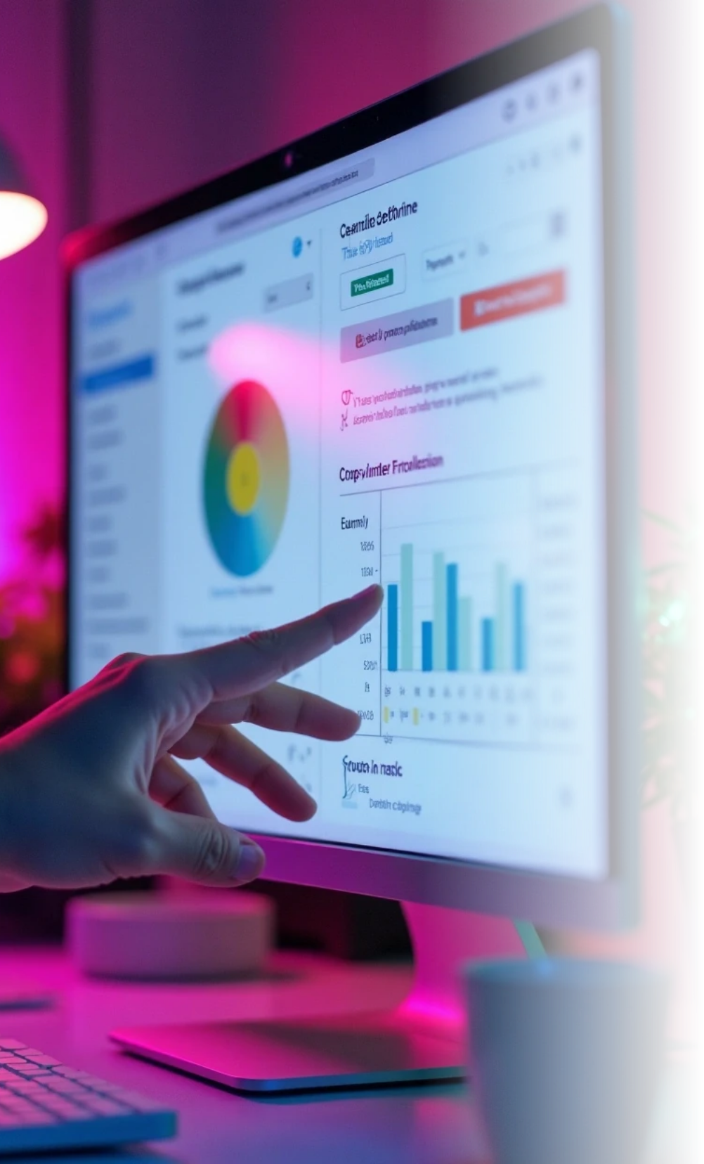

Adaptable System
AgriSense is designed to be easily adapted:
Add New Crops/Fertilizers: Simply edit the dictionaries in config.py. No code changes needed.
Change UI Appearance: Modify the STYLES and COLORS constants in config.py.
Introduce New Visualizations: Add new plotting functions to visualizations.py.
Support New Data: Update the schemas and validation logic in data_manager.py.

Slide 21
10
Installation and Usage

Slide 22


Getting Started
Get started in three simple steps:
Prerequisites:
• Ensure you have Python 3.7+ installed.
Install Dependencies:
pip install -r requirements.txt
• Clone or download the project files.
• Open a terminal or command prompt in the project directory and run:
Run the Application:
python main_gui.py
• Execute the main script:

Slide 23
11
Summary & Impact

Slide 24
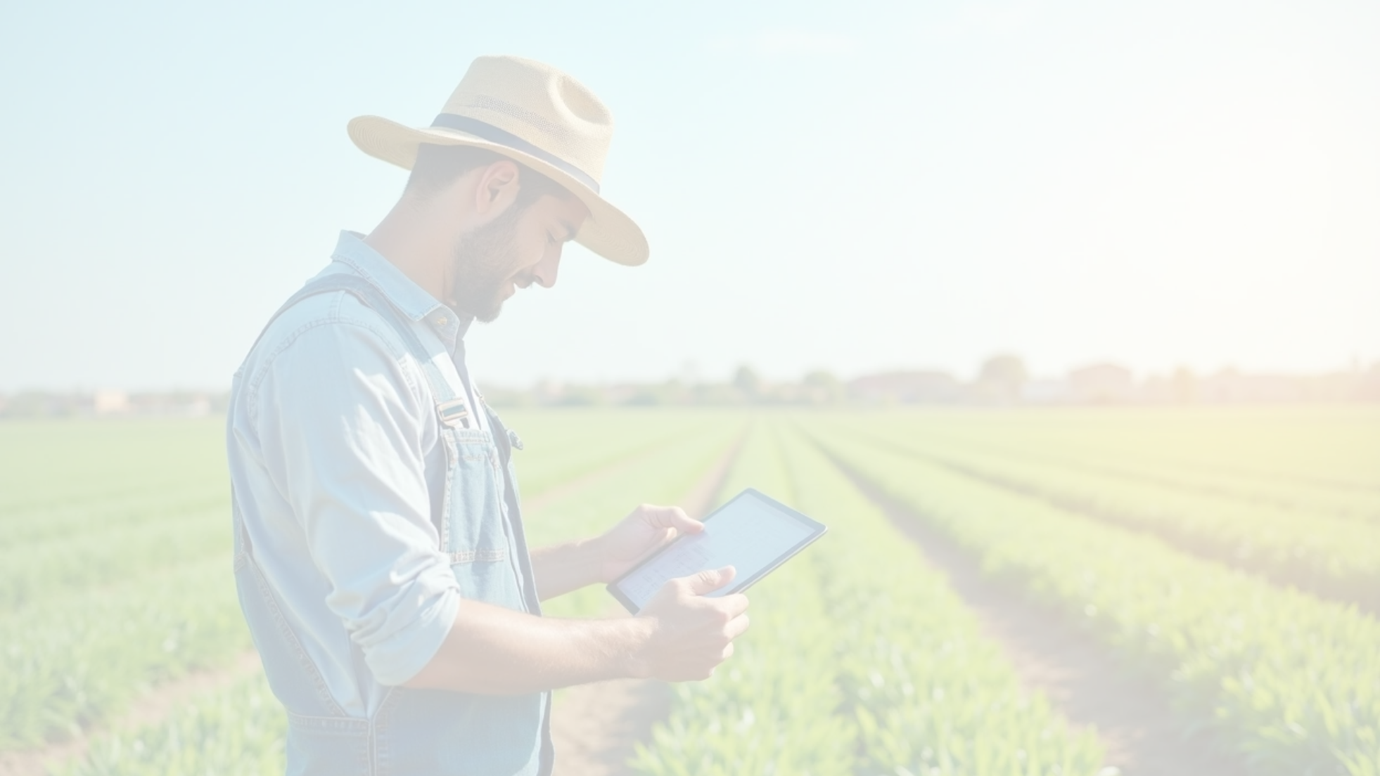

Conclusion
Problem
Modern farming needs accessible, data-driven decision-making tools.
Solution
AgriSense, a modular Python application that provides AI-powered crop, fertilizer, and yield predictions.
Key Features
• Three core prediction modules.
• Interactive data visualization.
• Simple data management.
Impact
• Promotes smarter farming practices.
• Ensures 100% data privacy with local processing.
• Offers a fast, robust, and customizable platform for agricultural analysis.
Happy Farming with AgriSense! 🌱🚜

Slide 25
12
Thank You & Q&A

Slide 26

Thank You & Q&A
Questions?

Slide 27
Thank You

